Slide 1
Component Photo Album
44-440/640-IoT

Slide 2
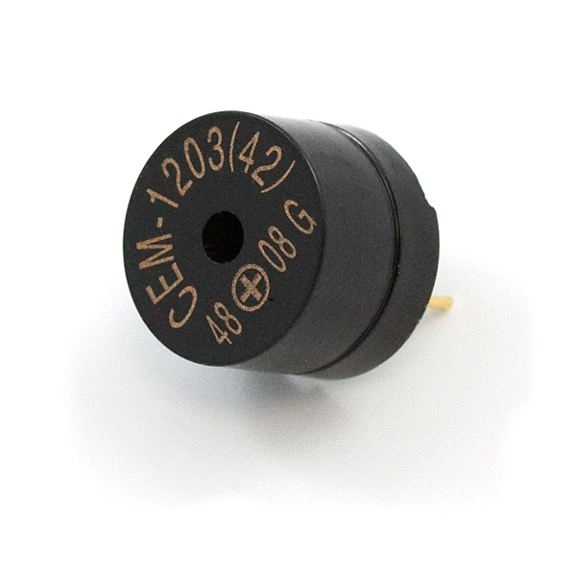
Piezo Speaker 1 COM-07950

Slide 3
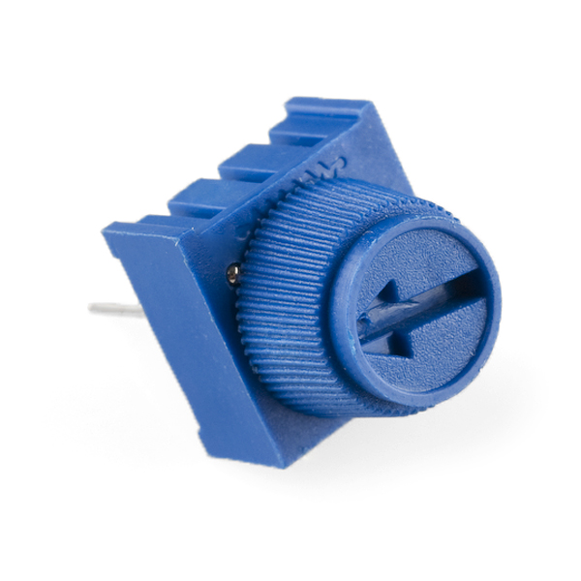
Trimpot 10K 1 COM-09806

Slide 4
Tactile Button 3 450-1804-ND

Slide 5
Resistor 330 330QBK-ND

Slide 6
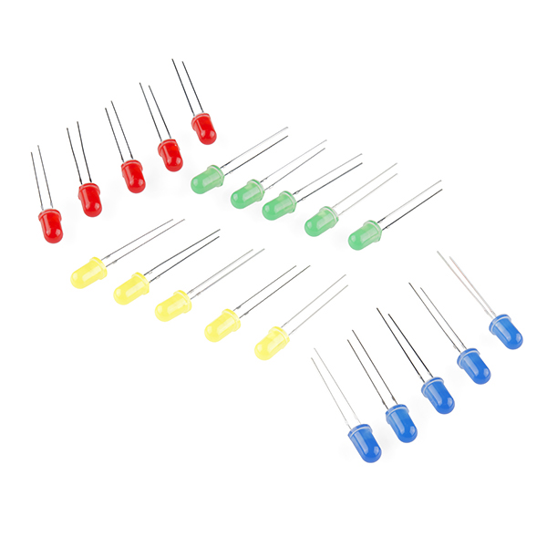
LED 3 COM-12062

Slide 7
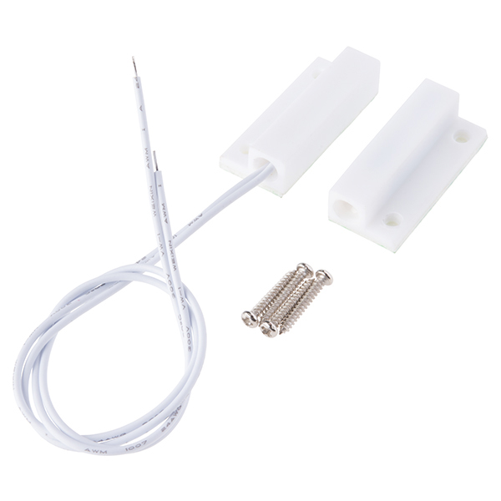
Magnetic Door Switch 1 COM-13247

Slide 8
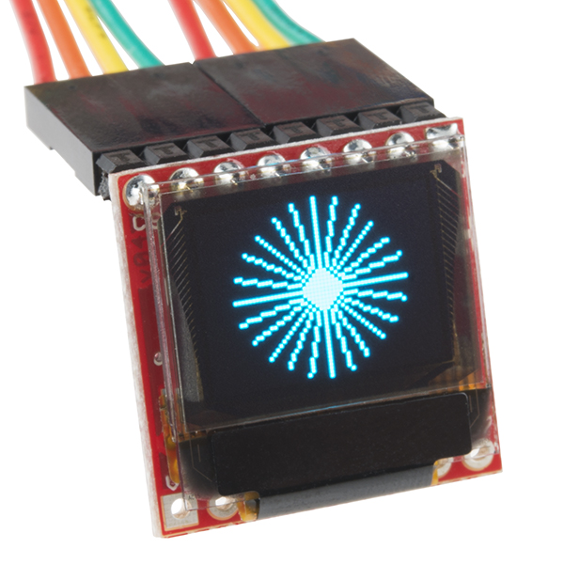
Micro OLED Breakout 1 LCD-13003

Slide 9
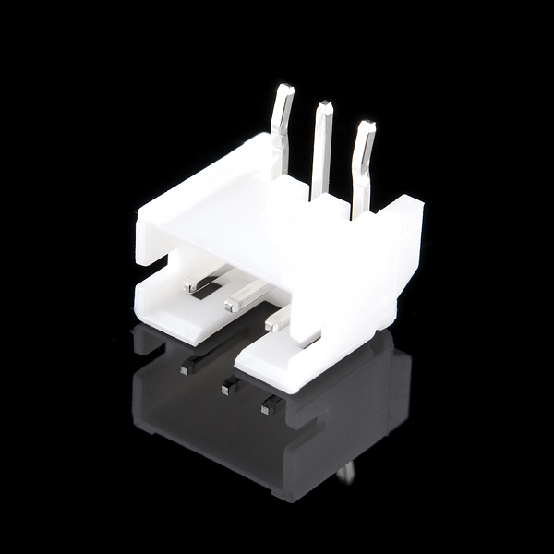
JST Right Angle Connector 0 PRT-09750

Slide 10
Breadboard 1 1528-2143-ND

Slide 11
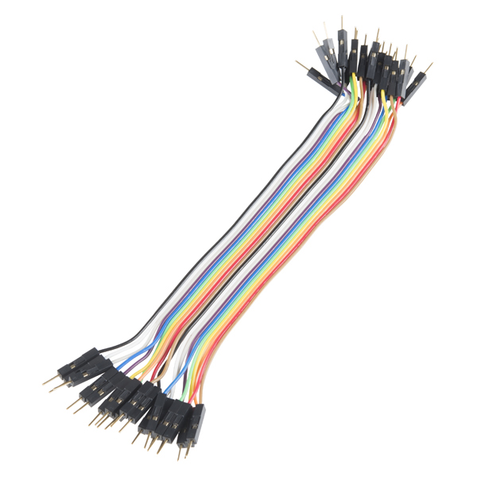
Jumpier Wires (20 pack) 1 PRT-12795

Slide 12
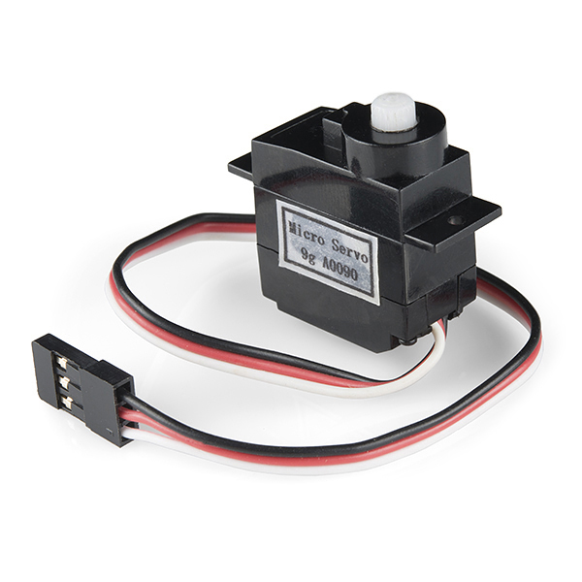
Servo 1 ROB-09065

Slide 13
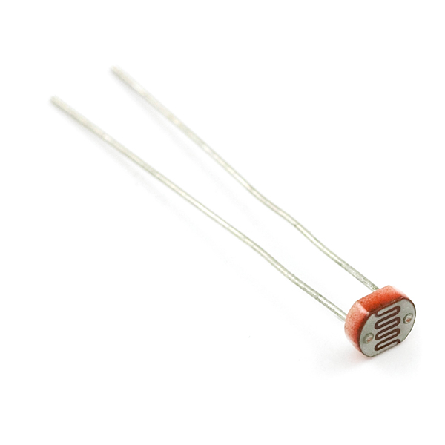
Mini Photocell 1 SEN-09088

Slide 14
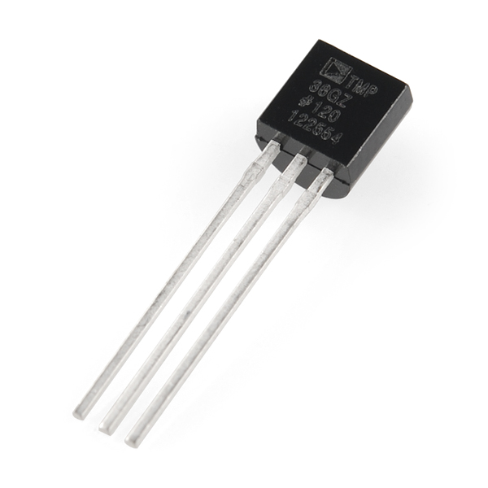
Temperature Sensor TMP36 1 SEN-10988

Slide 15
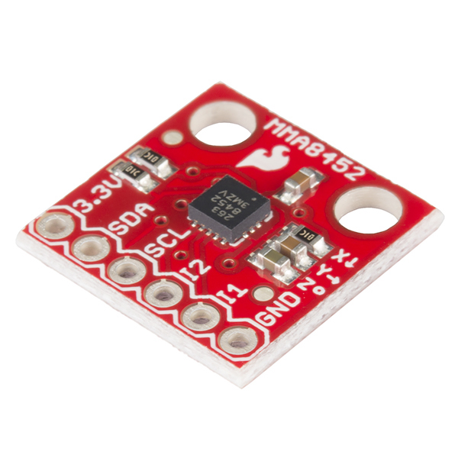
Accelerometer 1 SEN-12756

Slide 16
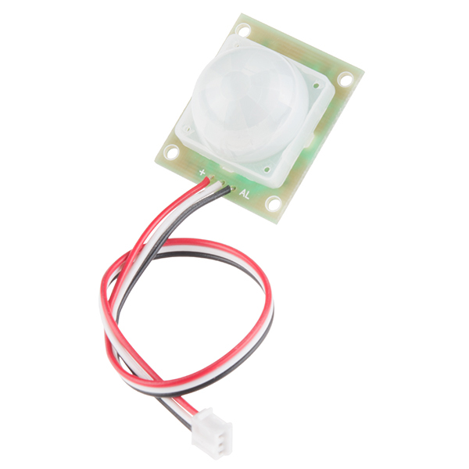
PIR Motion Sensor 0 SEN-13285

Slide 17
DHT22 Digital Temperature 1 SEN-13285

Slide 18
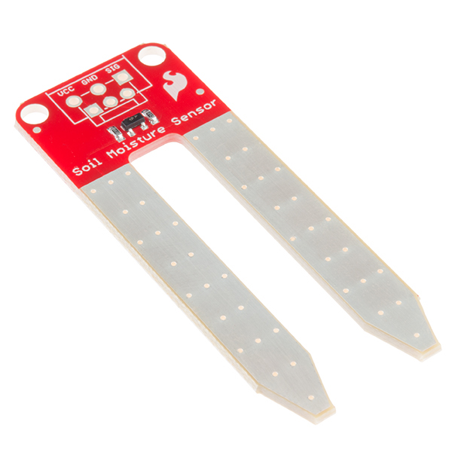
Soil Moisture Sensor 1 SEN-13322

Slide 19
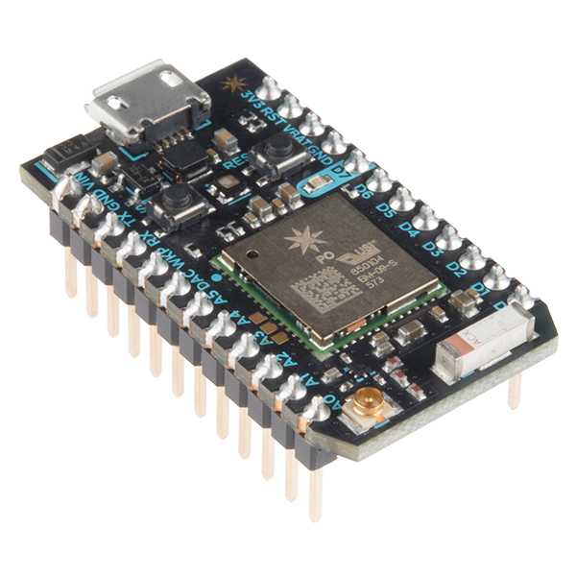
Particle Photon 1 WRL-13774

Slide 20
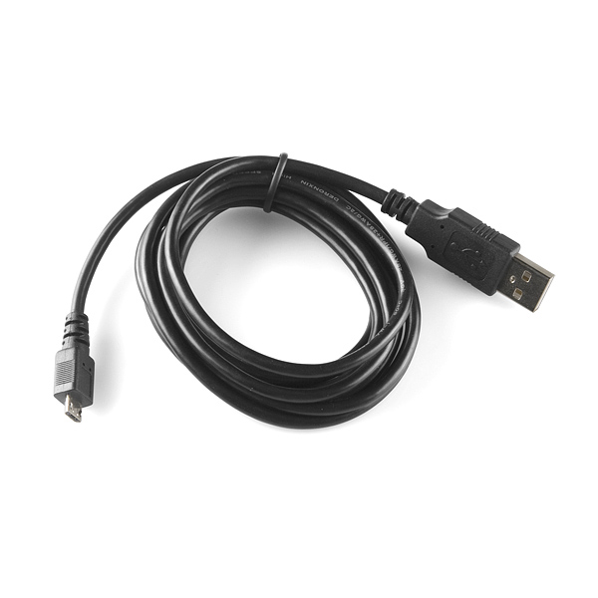
USB microB Cable - 6’ 1 CAB-10215

Slide 21
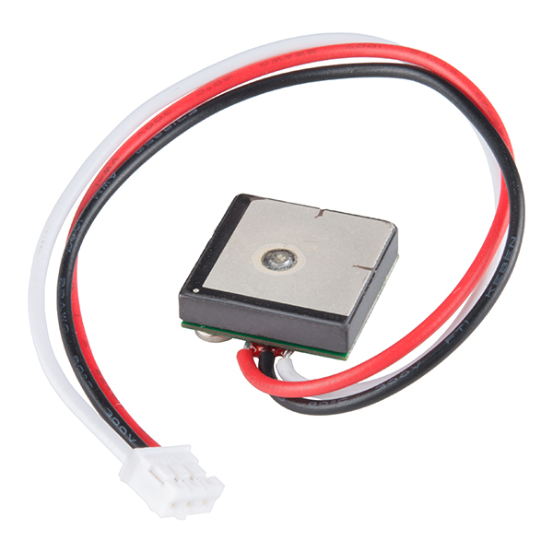
GPS Receiver - GP-20U7 1 GPS-13740

Slide 22
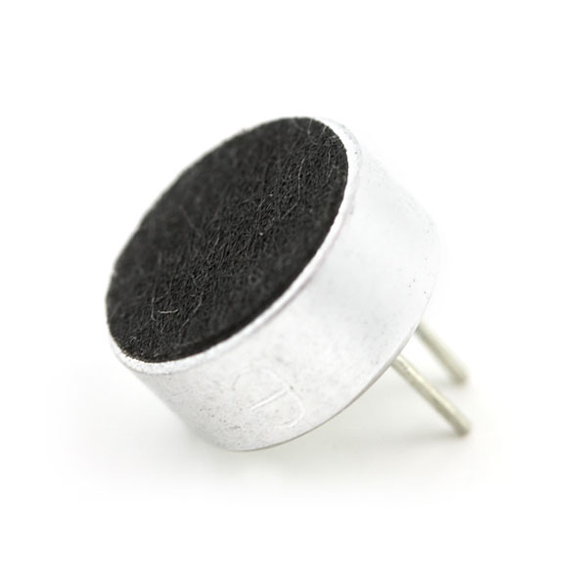
Electret Microphone 1 COM-08635

Slide 23
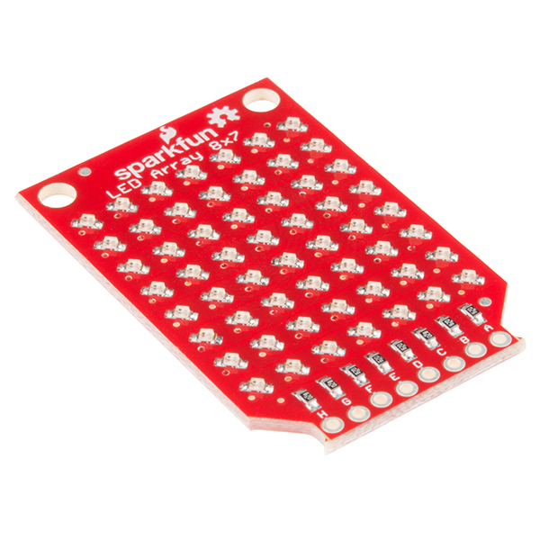
OLED Array 8x7 1 COM-13795

Slide 24
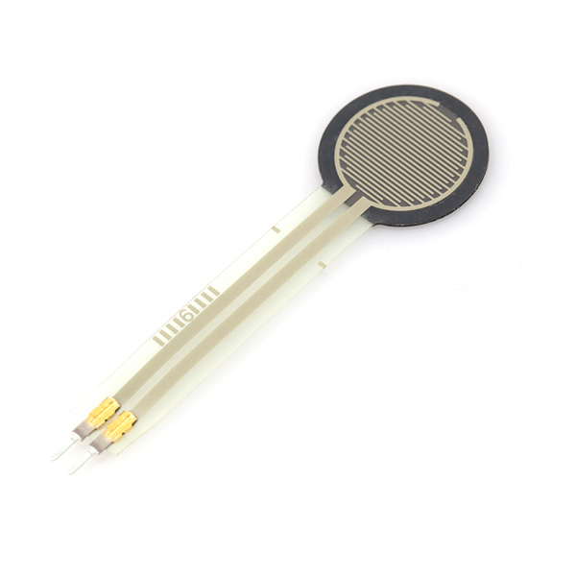
Force Sensitive Resistor 0.5” 1 SEN-09375

Slide 25
Tilt Sensor 1 SEN-10289

Slide 26
Vibration Motor 1 ROB-08449
Quarter not included 😎

Slide 27
Battery Holder 3xAA

